Slide 1
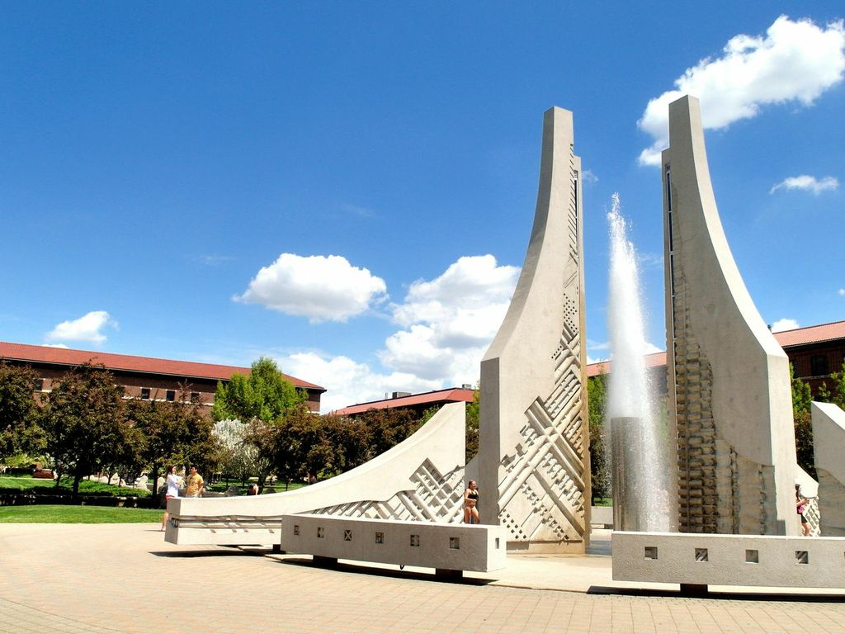
2013 Orientation 2013/08/18
http://web.ics.purdue.edu/~iltc/
Photo provided by Tzu-Ching

Slide 2
Outline
Welcome comment | Henry
2013-2014 ILTC activities | Ting
Transportation | Vicky
Grocery shopping | Jennifer
Dining | I-Fan
Entertainment | Amy
Buy a car | Tzu-ching
Club”s”!!!!
Car insurance | Helen

Slide 3
Introduction to ILTC
For Taiwan Students
Graduate: ILTC ( I Love Taiwan Club )
Undergraduate: TSA
Ways to reach ILTC
ILTC Website: http://web.ics.purdue.edu/~iltc/ChinesePages/Index.htm
Facebook:
Purdue ILTC

Slide 4
2013-14 ILTC Activities
By Ting

Slide 5
活動一覽
08/31 Global Fest 09/14 or 9/15 中秋烤肉 09/22 芝加哥建築之旅 10/12 or 10/19 Outlet shopping 01/2014(一月底) 新年晚會
01 or 02/2014 滑雪 03/2014 報稅說明會

Slide 6
Global festival
活動日期：8/31(六)
活動目的：宣揚國威！賺錢$$$
附註 ：新舊生一起high!
（光顧＆顧攤）

Slide 7
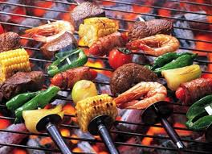
中秋烤肉
活動日期：9/14 or 15 (weekend)
活動目的：烤肉吃肉無限循環!
附註 ：大家一同共度佳節 :D

Slide 8
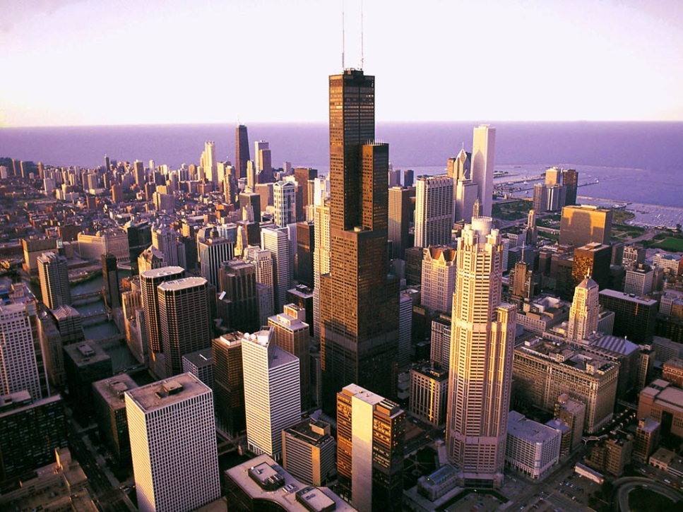
芝加哥建築之旅
活動日期：9/22(日)
活動目的：
走得腳很痠但為了美麗的芝加哥建築很值得!
附註 ：IIT主辦

Slide 9
Outlet Shopping
活動日期：10/19
活動目的：花錢!
附註 ：為寒冷的冬天做準備吧!
(手套/雪衣/毛帽/毛衣)
RSVP
$
Shopping
Net
work

Slide 10
新年晚會
活動日期：01/2014(一月底)
活動目的：在美國還是要過農曆年!
附註 ：開心吃團圓飯

Slide 11
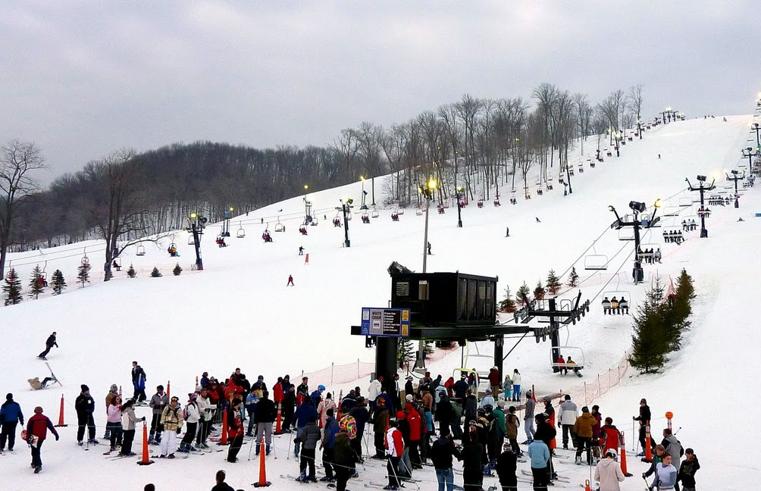
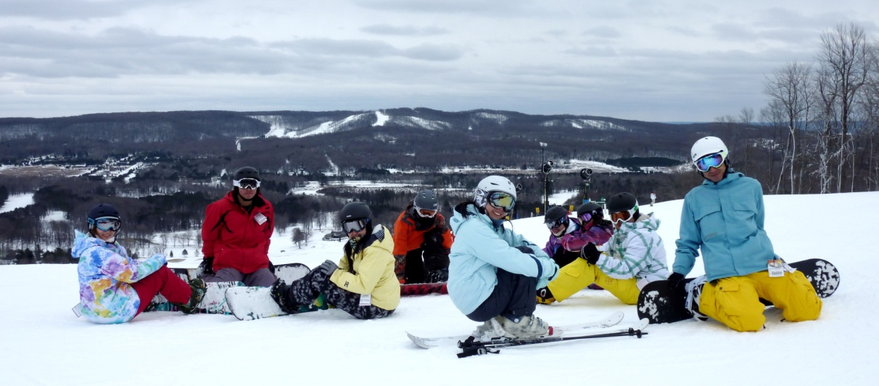
滑雪
活動日期： 01 or 02/2014
活動目的：體驗刺激並強健身心
附註 ：snowboard or ski

Slide 12
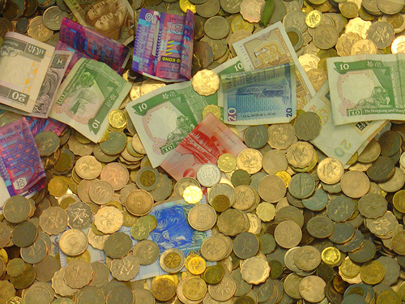
報稅說明會
活動日期： 03/2014
活動目的：教你怎麼吐錢給米國政府
附註 ：TA or RA/ Get tax back!

Slide 13
Transportation and Grocery hopping
By Vicky

Slide 14
Lafayette and WL: City Buses
City Buses
http://www.gocitybus.com
Free ride with student ID
Examples
West Lafayette -> Campus and Lafayette Downtown: 1B, 4B
Wal-Mart: 1B, 4B
Marsh, Payless: 1B
Lafayette Bus Station -> T mall: 4A ,1A

Slide 15
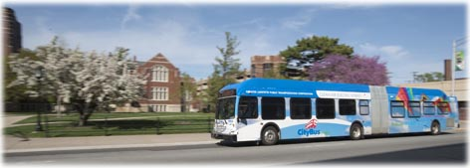
Campus: Campus Loop
Campus Loop
- Schedule and map in
http://www.gocitybus.com/campusloops.html
12 Gold Loop (to PV, TREC); 13 Silver Loop (to TREC)
Trolley (Wabash Landing)
Everybody rides free!

Slide 16
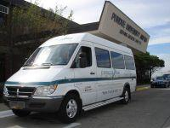
Go to Chicago or Indy!
Chicago
Amtrak Trains http://www.amtrak.com
3hr 33m
Greyhound http://www.greyhound.com/home
2hr 55m
Express Air Coach http://ww2.expressaircoach.com
3hr
Indianapolis (around 1.5 hour)
Star of America http://www.soashuttle.com/
Lafayette LIMO http://www.lafayettelimo.com/

Slide 17
Go to Chicago or Indy!
 | Where to take | Fares
Chicago
Amtrak | Downtown | $ 29
Greyhound | Downtown | $ 30
Express Air Coach | Purdue Airport | $ 65
Chinese-龍杰 | 電洽 (630 721 0226) 646 251 5883 | 電洽
Indy
Lafayette LIMO | PMU | $ 27/50
Star of America | PMU | $ 19 (free Wi-Fi)

Slide 18
Parking on campus
C Permit (living off-campus)
Hawkins or PV permit (for residents only)
A Permit (Fellowship or visiting scholar)
Parking map: http://www.purdue.edu/pat/mainnav/parking/pdfs/Parking_Map_08_2010.pdf
Parking permit fees and regulations:
http://www.purdue.edu/pat/mainnav/parking/students.htm
Speed Limit: 20/10 mph in campus/garage

Slide 19
Grocery Shopping
By Jennifer

Slide 20
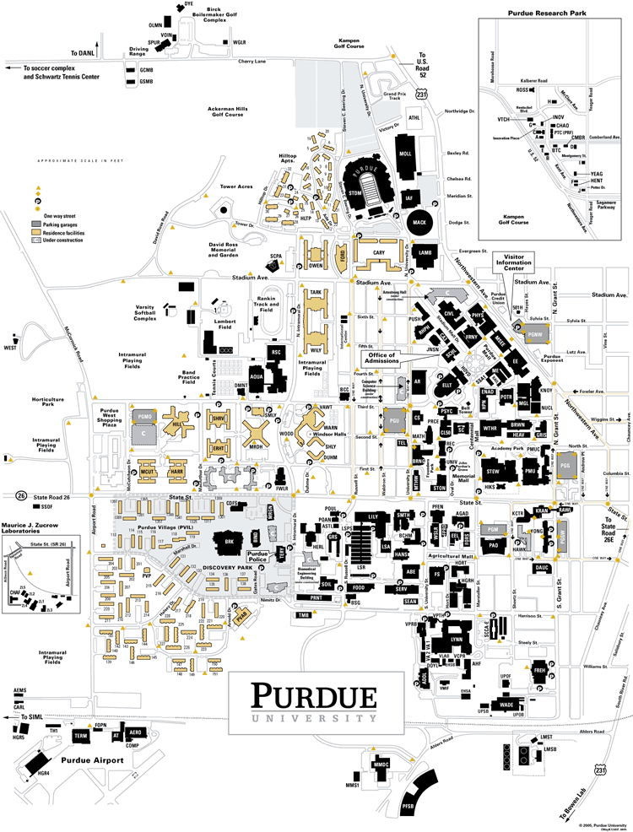
Purdue Campus
Purdue University
Visitor Center
Bring the campus map
with you all the time
Landmark:
The Purdue Bell Tower
Maps of Purdue, West
Lafayette, and Indiana

Slide 21
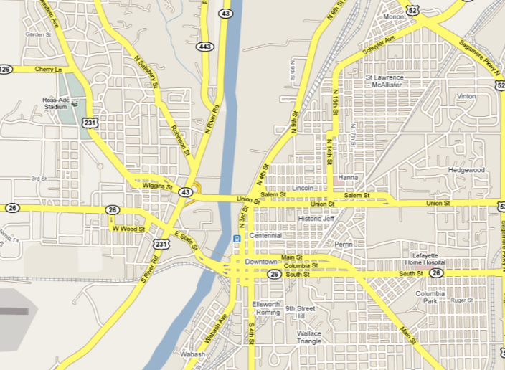
West Lafayette / Lafayette
Wabash River
West Lafayette
Lafayette

Slide 22
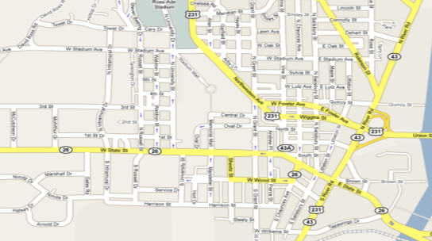
Grocery Shopping 1
Walking distance from campus
1. Food Mart (Mid-Eastern) South street, West Lafayette
2. Oriental 東方店 (Chinese) Brown Street, West Lafayette
3. Smith Hall (for Meat products-Wed: 3:30~5:30, Fri: 3:30~5:30) On Campus
4. Purdue Village Garden (fresh vegetables)
3.
1.
2.
3
1
2
4.
4

Slide 23
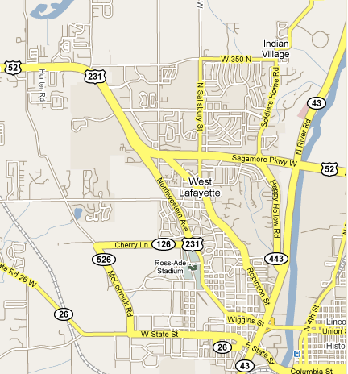
Grocery Shopping 2
West Lafayette
1. Asia Market (2400 Yeager
Road, West Lafayette) 5
2. Marsh Supermarket* 1B
3. Payless Supermarket* 4B
4. Wal-Mart* 4B, 1B
5. Hana Market (Korean) 4B
(* Water refill available)
5.
5
4.
1
3.
2
4
1.
3
2.

Slide 24
Grocery Shopping 3
Lafayette
Wal-Mart*
Target
Meijer*
Sam’s Club: Large Quantity, Membership required
Marsh Supermarket*
Payless Supermarket*
(* Water refill available)

Slide 25
Dining
By I-Fan

Slide 26
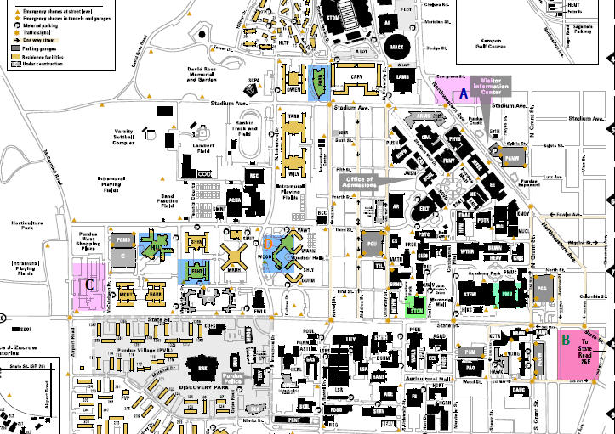
On-Campus Dining
HTM Cafe
PMU
We’re Here!

Slide 27
Area A: Stadium & Northwestern
American
McDonald’s
Café Royale

Slide 28
Area B: Chauncey Hill
American
Potbelly (Sandwich)
Einstein Bagel
Arby's Roast Beef Restaurant
Jimmy John's (Sandwich)
Subway (Sandwich)
Browny's Pizza King
Asian
Maru (Japanese and Korean)
Basil Thai (Thai)
Rice Café (American Chinese)
富臨 (Chinese)
Khana Khazana Indian Grill
Other
Captain Gyros (Greek and American)
Fiesta (Mexican)
Parthenon (Greek)
Chipotle (Mexican)
Qdoba Mexican Grill

Slide 29
Area C: Purdue West
American
Papa John’s
Dairy Queen (Ice cream & Fast Food)
Subway
Asian
China Dragon

Slide 30
Off-Campus Dining
Oriental (take trolley)
Buffalo Wild Wings
Kibu, Green Leaves, Bombay
C
A
Movie Theatre
B
Use Google Map!
30

Slide 31
Area A: River Road and State Street
American
Triple X (Brunch)
Domino’s (Pizza)
Asian
Kibu Café (Korean and Japanese)
Bombay (Indian)
Green Leaf (Vietnam)
8/18/2013
31
Notes:
31

Slide 32
Area B: River Market
American
Silver Dipper (Ice cream)
Marco’s Pizza
AJ’s Burger and Beef
Bruno’s
Asian
Oishi (熱炒、湯麵)
Happy China (Chinese)
32
Notes:
32

Slide 33
Area C: Brown Street
American
Buffalo Wild Wings Grill and Bar (Wings, Burger)
Asian
天香樓(Chinese)
Other
Puccini’s (Italian)
9 Irish Brothers (Irish)
El Rodeo (Mexican)
8/18/2013
33
Notes:
33

Slide 34
早餐新選擇
8/18/2013
34
Notes:
34

Slide 35
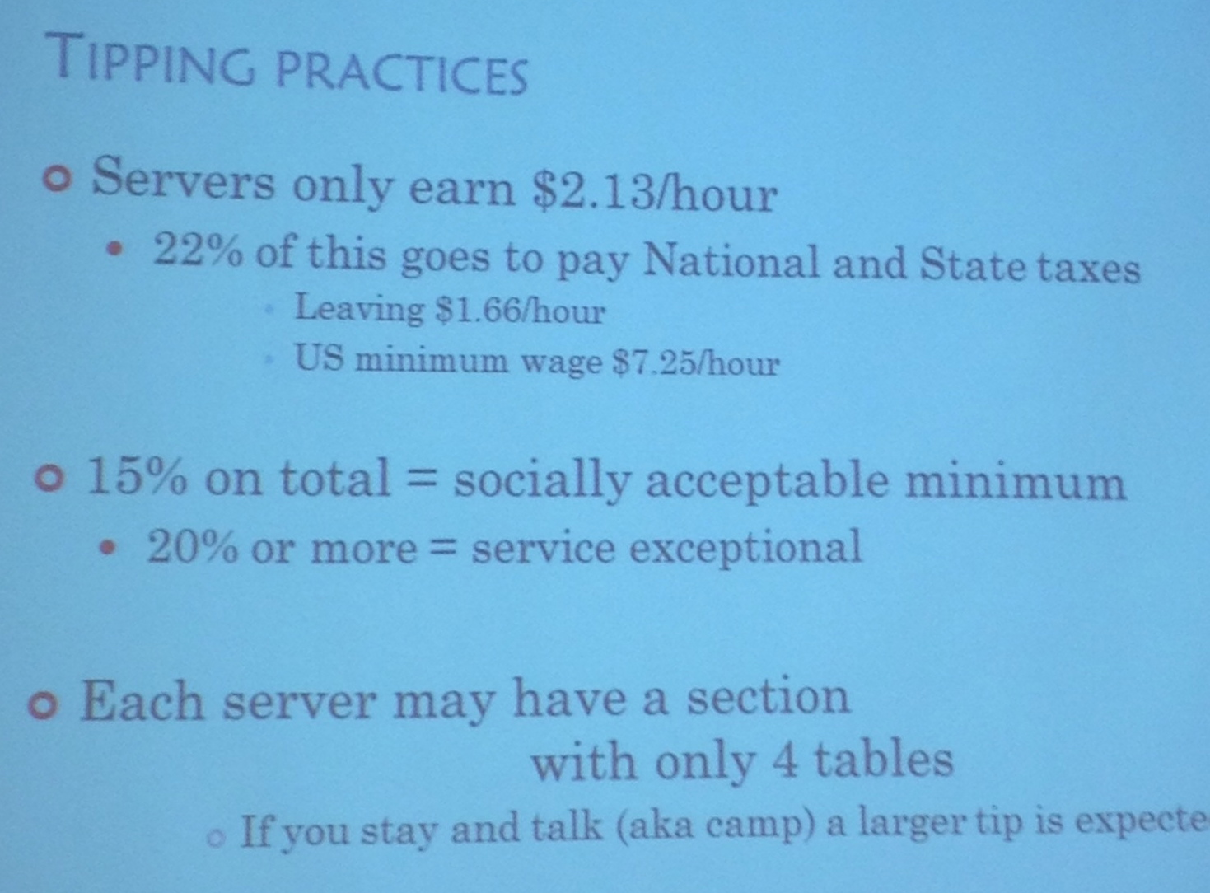
Tips
8/18/2013
35
Notes:
35

Slide 36
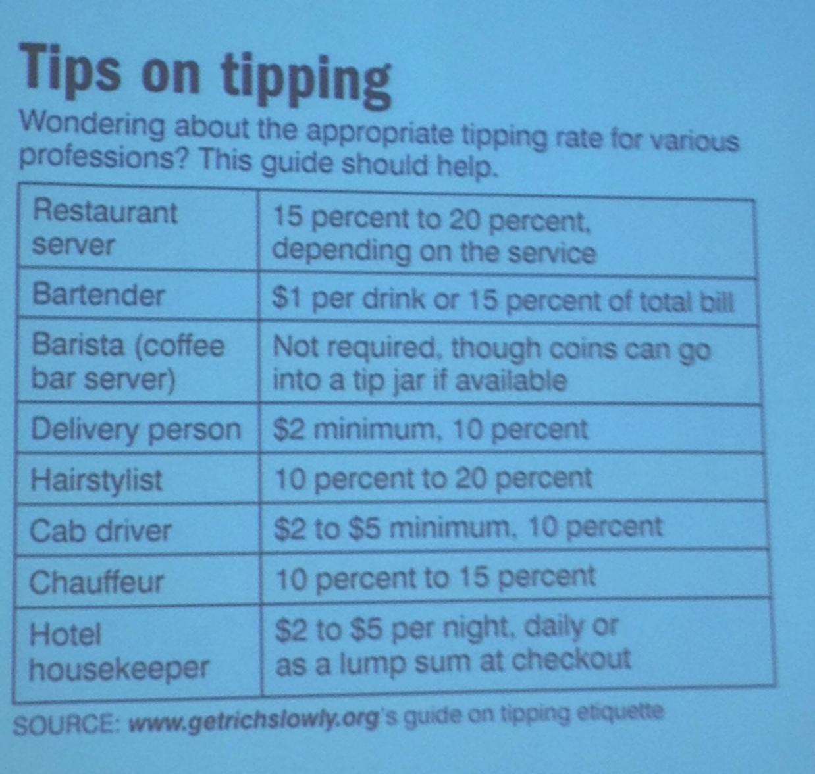
Tips
8/18/2013
36
Notes:
36

Slide 37
8/18/2013
37
Notes:
37

Slide 38
Entertainment
By Amy

Slide 39
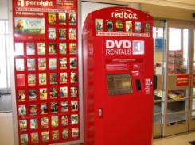
Books, DVD and Movies
Books: Von’s
DVD rentals: Red Box
Movies: 1. Wabash Landing 9 2. Stewart Center (Fowler)
Fri & Sat evenings $3
West Lafayette Public Library
Movie rentals
Free application with PUID

Slide 40
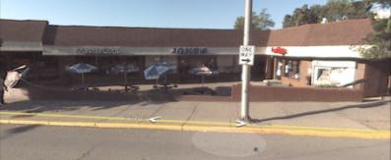
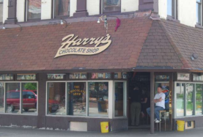
Meeting and Party
Karaoke: Echo (Taiwanese)
Bars On campus (around Chauncey Hill): Jake’s, Harry’s, Egyptian(Hookah),
where Else, etc.
Club: Neon Cactus in the Levee Plaza
Buffalo Wings: Sport events
Lafayette downtown: Chumley’s Black Sparrow
Breakfast club
PS. Bring your ID !!!

Slide 41
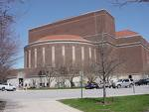
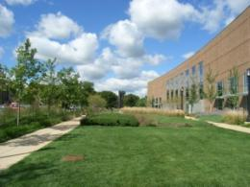
Performing Art & Theatre
Purdue Convocations
Elliot Hall of Music
Purdue Theatre
Pao Hall of Visual and Performing Arts
Hansen Theatre
Art Exhibition: Stewart Center Main Floor
Summer concerts
Performing Arts: Long Center in downtown Lafayette
Chicago: YOU GET EVERYTHING!

Slide 42
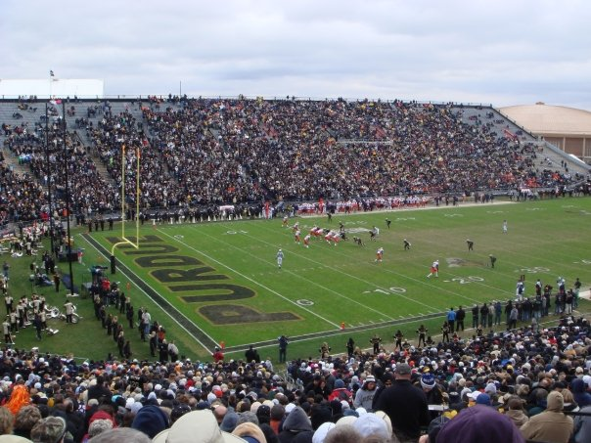
Sports
ILTC club
Gym (COREC)
Bowling (PMU)
Golf and mini-golf
Professional Sports
Football (Indy)
Basketball (Chicago, Indy)
Baseball (Chicago, Cincinnati)
- Indianapolis 500 – car racing!
NCAA
Football (fall!)
Basketball (spring!)
(Discounts on University Book Stores )
Baseball Big Ten competitions

Slide 43
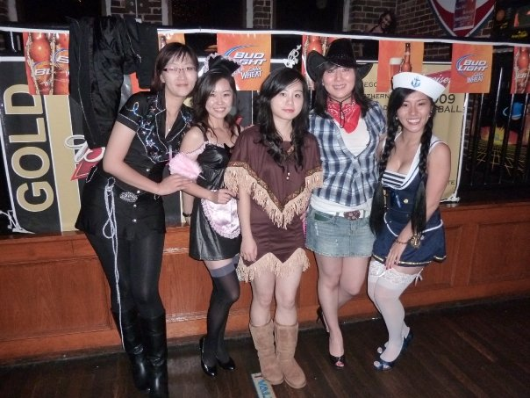
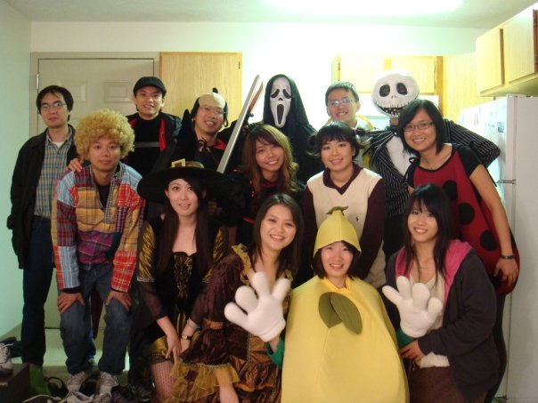
Seasonal(1)
Fall
Global Festival (ILTC)
Starry Night
Hunter’s Moon
Halloweens
Trick or Treat
Custom Party
Pumpkin Carving
Job Fairs
Thanksgiving
Big Turkey Meal
SHOPPING!
Winter
Christmas and New Year Eve: Ice-skating and traveling!

Slide 44
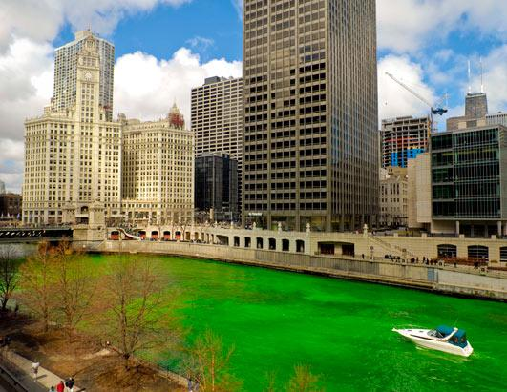
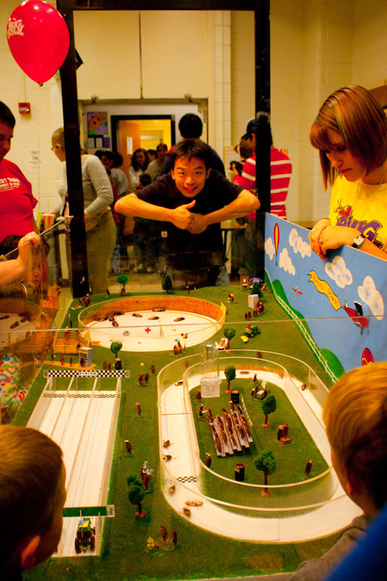
Seasonal(2)
Spring
Easter: Church Events, Easter egg hunting
Saint Patrick Day: All green
Spring Festival(second weekend of April)
Grand Prix (April)
Summer
Fourth of July: Fireworks

Slide 45
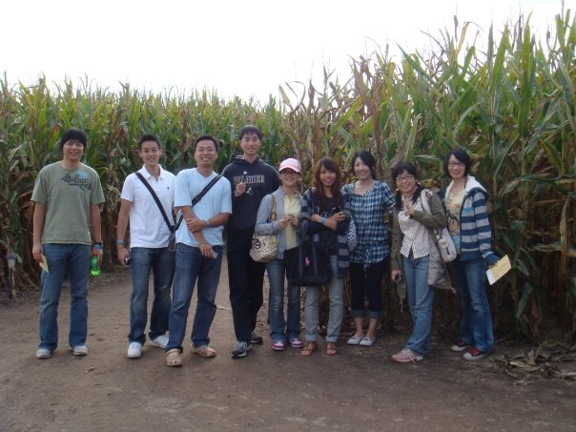
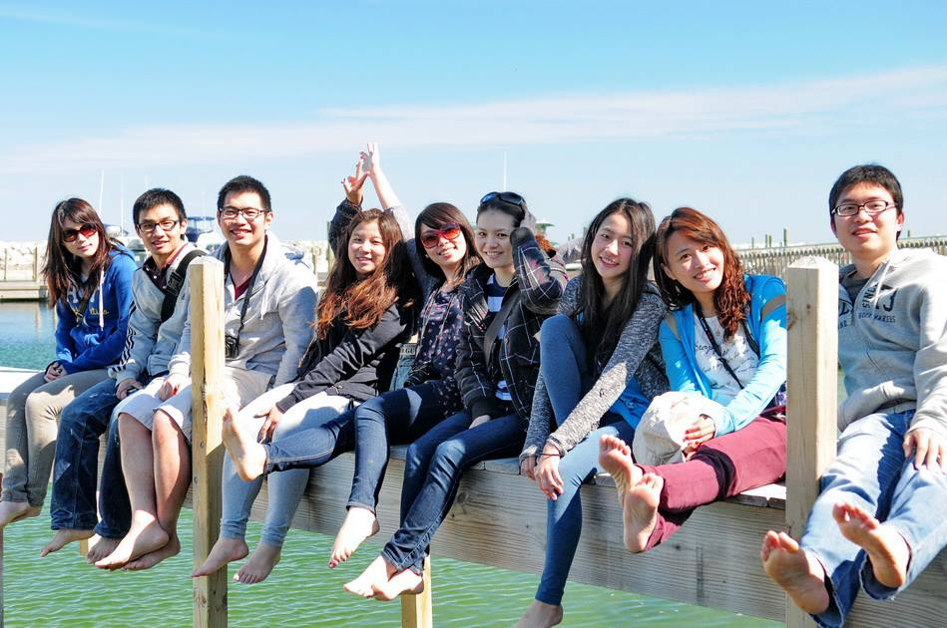
Happy hallow
Wolf Park
Corn Maze
Battle Ground
Turkey Run State Park: Canoeing, fishing, Camping
Indiana University
Carmel
Brown county state park (Nashville)
Chicago : Six Flags, Michigan Lake Shore
Smokey mountain

Slide 46
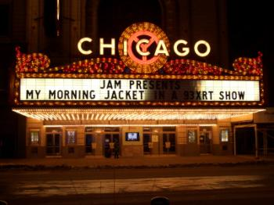
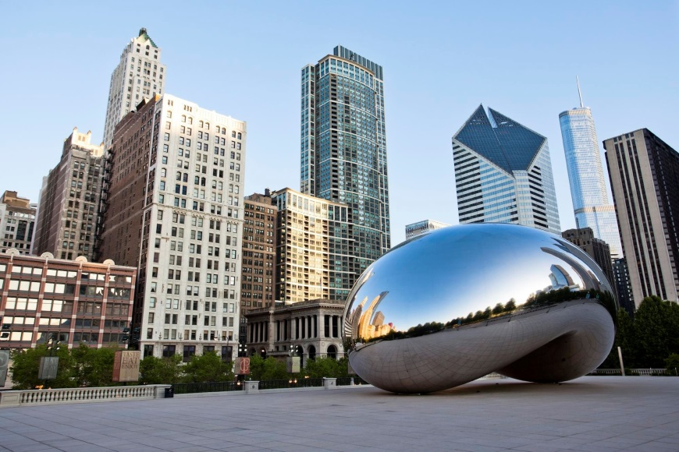
Traveling (Chicago)
NBA, MLB
Millennium Park
Museum Park
Michigan Lake
Michigan Avenue
John Hancock
Sears Tower (Willis)
Lincoln Park
Navy Pier
China Town
Night Club (Chicago Jazz, etc)
Blue man

Slide 47
Entertainment - summary
Where to get information?
Hawkins hall or ISS
Purdue Information Center
Stewart Center or PMU
Look at the Bulletin Boards and brochures
Purdue Website- under Purdue Events
Newspaper
Facebook!
JEFF !!
Join → Eat → Friends → Fun

Slide 48
Purdue ILTC 2013 Orientation
- Something about Cars
2013 8/18
Purdue University Speaker: Tzu-Ching Wu 子青

Slide 49
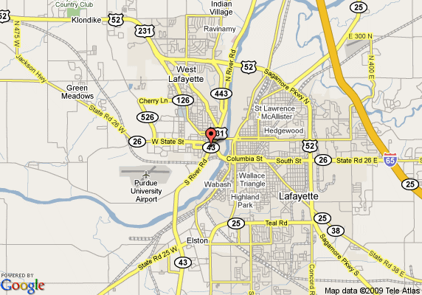
Q1. Do I need to buy a car?
其他交通方案:
1.步行
2.腳踏車
3.公車
4.共乘

Slide 50
Q2. What should I do before buying a car ?
►汽車駕照 Driver’s License
地點: BMV
準備文件: (1)護照+美簽(算兩個)+(學生證+I20)
(2)提出能證明居住在本地的證明文件x2。
(3) SSN, 沒有SSN的話，要到Social Security
Administration申請social security waiver。
流程: (1) 如果沒有國際駕照需先拿學習駕照
(2) 到BMV進行筆試
(3) 通過筆試當場預約路考
(4) 路考通過拿到駕照

Slide 51
II. Buying a Car
1. New Cars or Used Cars?
2. Purchase Price – New Cars
3. Purchase Price – Used Cars
4. Dealer Price Quotes

Slide 52
1. New Cars or Used Cars?
►新車或二手車?
1. 新車在前2-3年價值劇烈下降
2. 收入狀況
3. 開車距離如何
4. 持有車的時間
5. 對於車功能的要求
6. 對汽車的瞭解

Slide 53
2. Purchase Price – New Cars
價格查詢網站
Kelley Blue Book (KBB) http://www.kbb.com/
Edmond’s Guide http://www.edmunds.com/
CarsDirect http://www.carsdirect.com/home
如何查詢新車價格?
(a)車廠 (b)型號 (c)年份
如何查詢二手車價格?
+ (d) 里程數(Mileage) (e) 賣家 (f) 狀況 (g) 其他條件
甚麼是MSRP價格: Manufacturer's Suggested Retail Price
甚麼是Invoice價格

Slide 54
2. Purchase Price – New Cars
►以新車為例:
Kelly Blue Book (KBB) http://www.kbb.com/

Slide 55
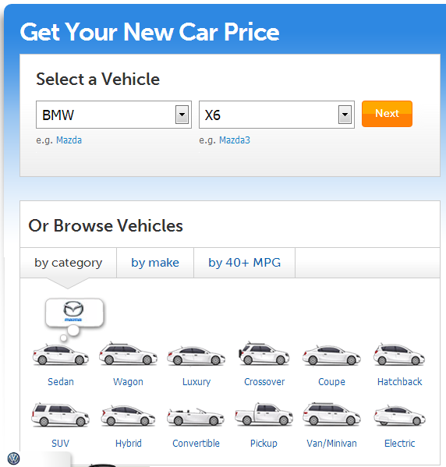
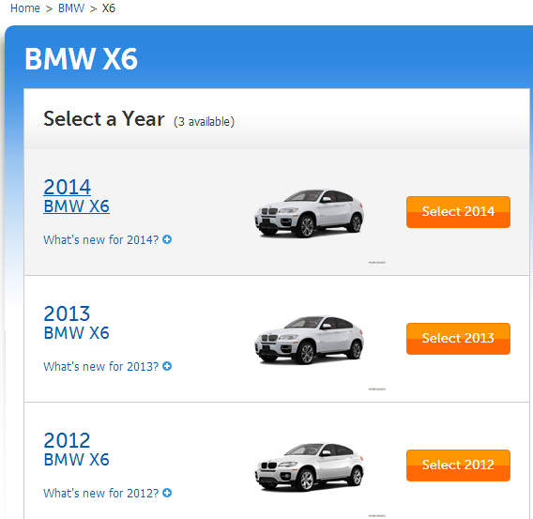
2. Purchase Price – New Cars

Slide 56
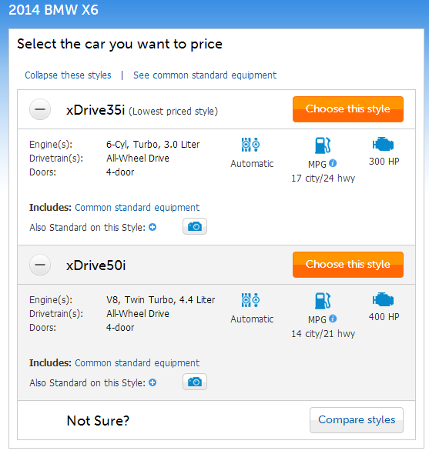
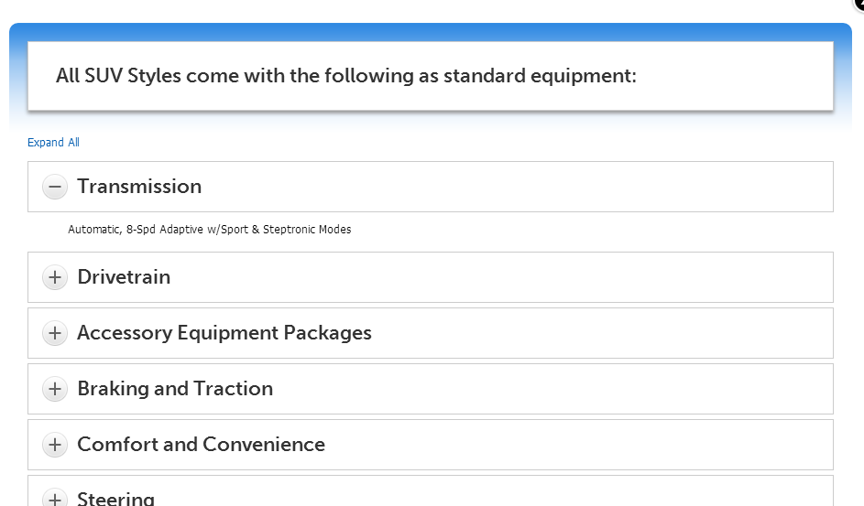
2. Purchase Price – New Cars

Slide 57
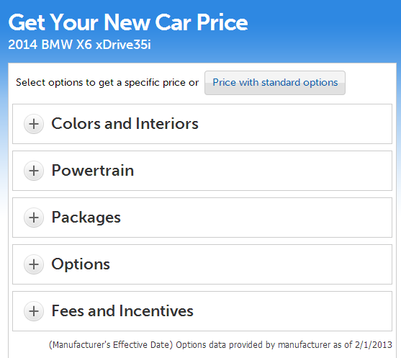
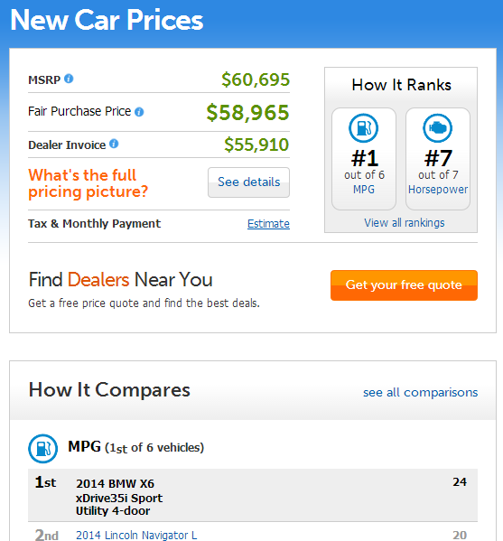
2. Purchase Price – New Cars

Slide 58
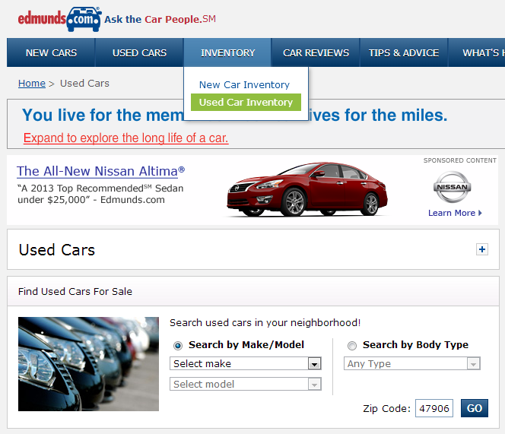
3. Purchase Price – Used Cars
►以二手車為例:
Edmond’s Guide http://www.edmunds.com/

Slide 59
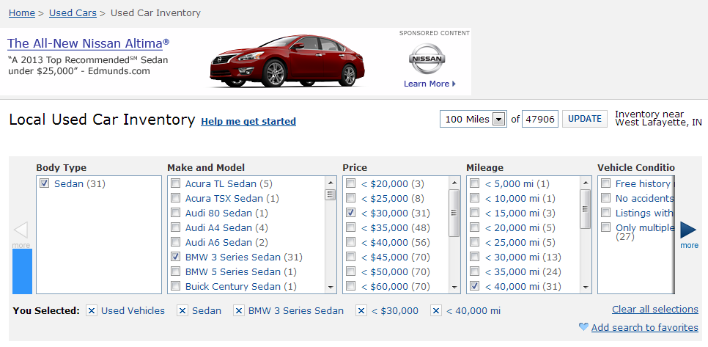
3. Purchase Price – Used Cars

Slide 60
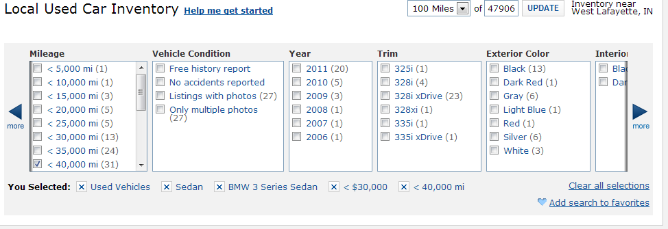
3. Purchase Price – Used Cars

Slide 61
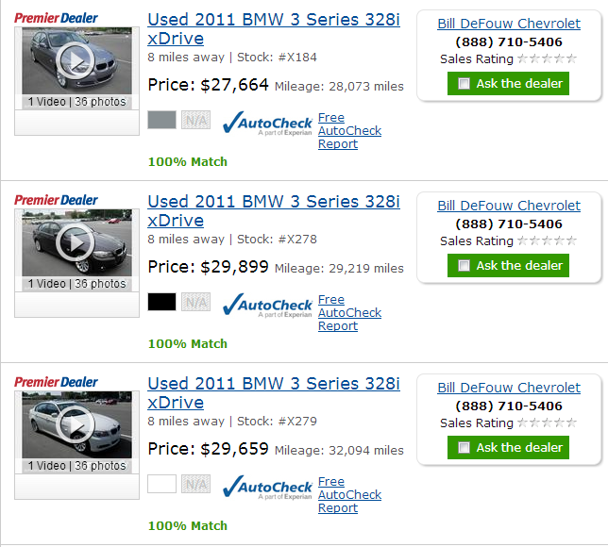
3. Purchase Price – Used Cars

Slide 62
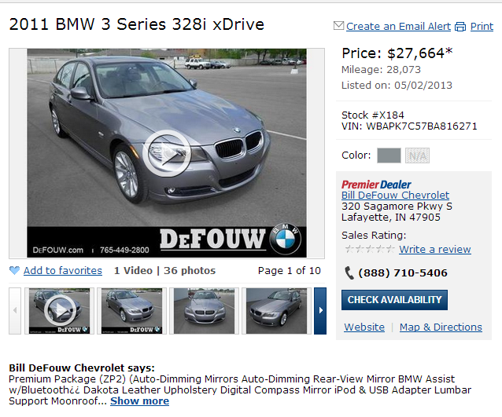
3. Purchase Price – Used Cars

Slide 63
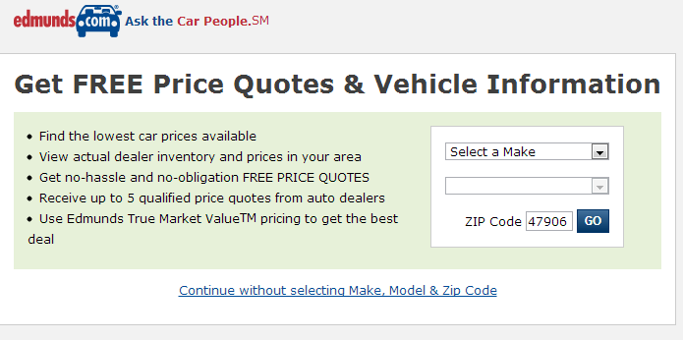
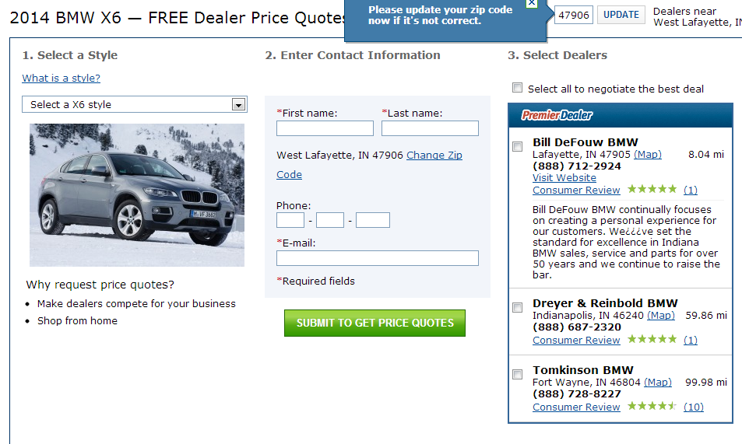
4. Dealer Price Quotes
►MSRP及Invoice價格:

Slide 64
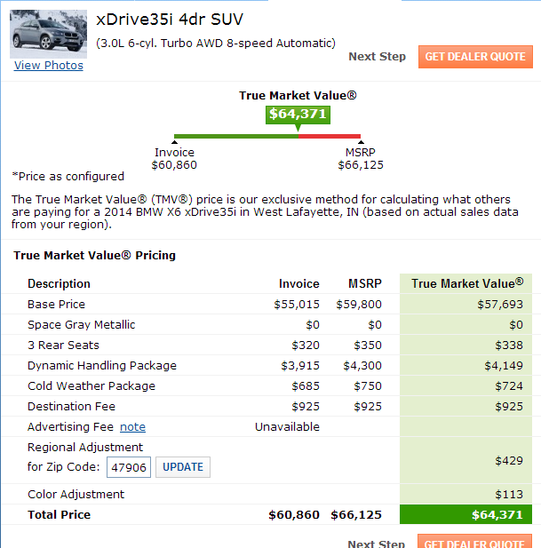
4. Dealer Price Quotes

Slide 65
III. Car Buying Notices
4. Purchase from the Dealer
5. Notices for Buying Used Cars
6. Others

Slide 66
4. Purchase from the Dealer
►如何和Dealer交易
1) 確定要買的車型和價格, 並尋找附近的dealer
2) 聯絡預約或現場試車
3) 請勿表現急於買車心態, 可多議價幾次
* 歐系車一般會靠近MSRP價, 日本車很少低於發票價,
但會低於MSRP. 美國車很可能低於MSRP價
* 一般七八月月份和十二月份較有好價格, 或月底.

Slide 67
4. Purchase from the Dealer
►如何和Dealer交易
4) 談好價格後就是付款, 並需確保各項車輛資訊
5) 並確保包含行照及牌照
* 會先發給你臨時牌照, 在期限內至BMV辦理正式牌照.
6) 需有汽車保險才能上路

Slide 68
5. Notices for Buying Used Cars
►買二手車還需注意哪些事項?
1) 看好車後, 到CARFAX http://www.carfax.com/entry.cfx
查詢車輛歷史紀錄包括前車主, 做過保養維修及發生事故紀錄.
2) 購買二手車前建議找修車場作全面檢查
3) 車輛是否為salvage or reconditioned title?
* 歐系車一般會靠近MSRP價, 日本車很少低於發票價,
但會低於MSRP. 美國車很可能低於MSRP價
* 一般七八月月份和十二月份較有好價格, 或月底.

Slide 69
6. Others
►其他注意事項?
1) 日系車或美系車?
2) 要在Lafayette, Indy, or Chicago買車?
3) 買車前你應該詢問車主的問題
http://www.carbuyingtips.com/questions.html
4) 十種最值得購買的二手車(J.D. P. A 2010調查報告) :
Hyundai Elantra, Honda Accord, Mercury Montego, Honda CRV,
Toyota Highlander, Infiniti G35, Cadillac DTS, Toyota Tacoma,
Ford F-150, Porsche 911

Slide 70
Taiwanese Clubs
ILTC : Henry
Purdue Taiwan wife club: Wanling
Volleyball : 渣
Wallyball : Amy
Softball : 許全智
Badminton : Tzu-Ching
Tennis : Wei-chang
Basketball : 士奇
團契 : Ya-Chu
請大家sign up 有興趣的clubs!!

Slide 71
Purdue Taiwan wife club

Slide 73
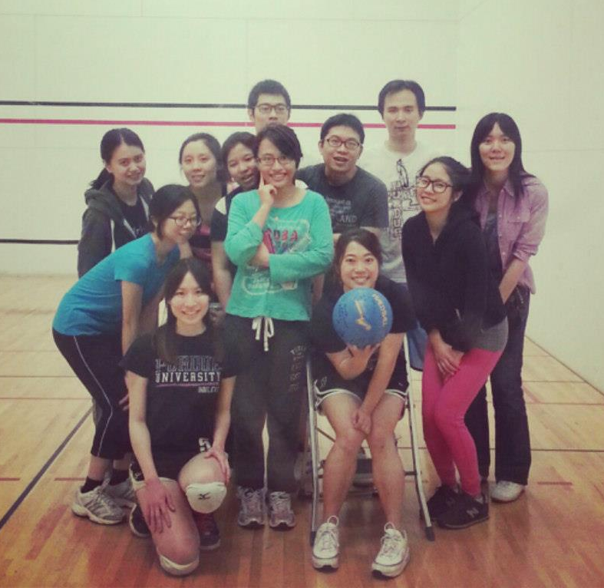
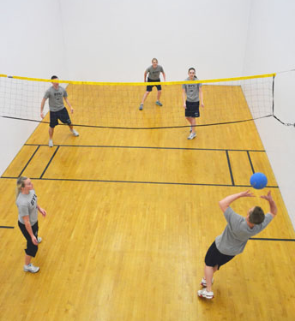
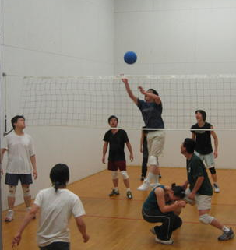
Wallyball
時間：Wed 6 pm
地點：Crec, Racquetball & Squash Courts, Level 2
徵人條件：不要想太多，想玩就來!
聯絡人：Amy
(hung6@purdue.edu)

Slide 74
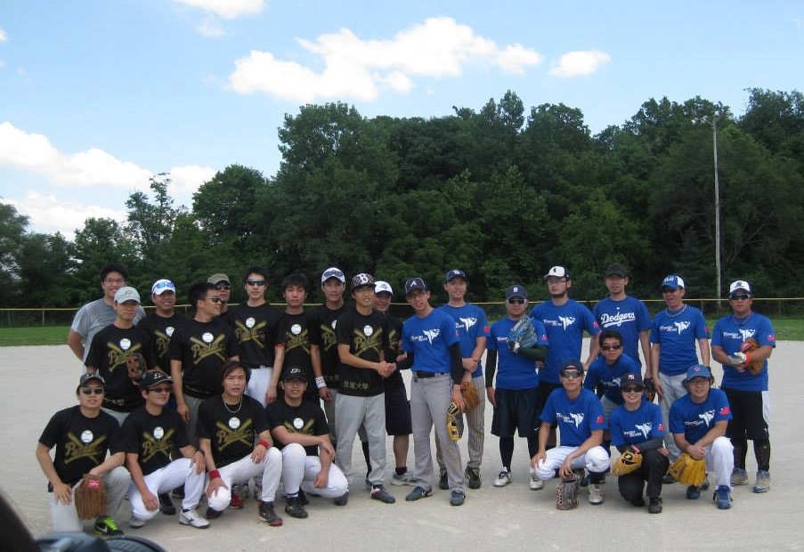
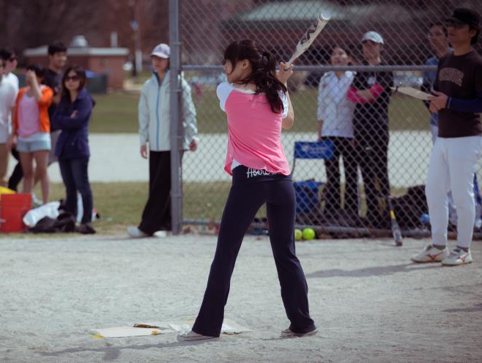
Softball
練習時間:週六或週日下午
練習地點:Gold Field (Co-rec後面壘球場)
年度活動:
新生盃壘球比賽
芝加哥友誼賽
玉米田盃
聯絡人: 許全智 without1102@gmail.com

Slide 77
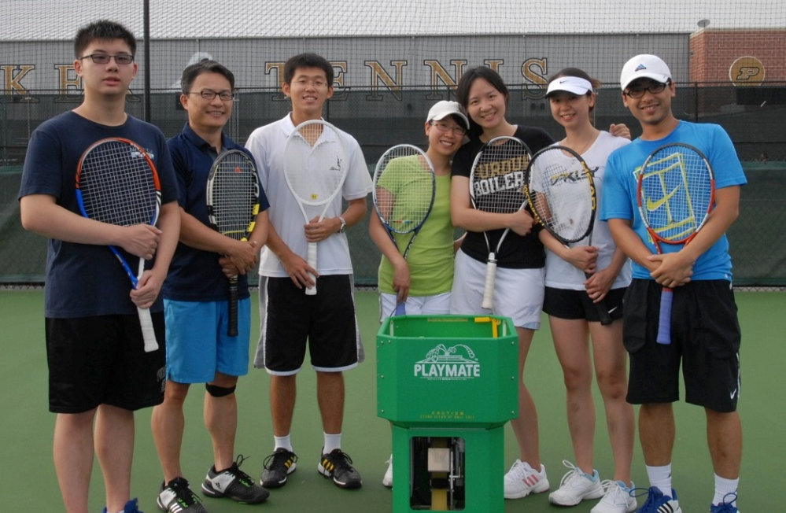
Tennis for Everyone
When: Saturday 6-8 pm
Where: Schwartz tennis center or Cumberland Elementary School
Why: Because it’s fun! ☺
Contact: 楊偉昌 Wei-Chang (David) Yang (weichang252@gmail.com)
Group on Facebook: Search Purdue ILTC Tennis
Left to right: Alan, Prof. Lu, Sherwood, Stephanie, Kerina, Hsing-Hui, David
超強教練

Slide 78
Basketball
宗旨：Have fun!!
時間：星期六早上10點半
地點: corec三樓球場
徵人條件：
有看過灌籃高手的人
聯絡人：
Chien Sheng Liao
cksearching@gmail.com

Slide 79
拉法葉華人宣道會 GREATER LAFAYETTE CHINESE ALLIANCE CHURCH
聚會地點 /Location: Wesley Foundation
聚會時間/ Time
主日崇拜 / Sunday 11am-12:15pm
禱告會/ Tuesday 5:30pm-6:30pm
學生團契 / Friday 6:00pm-9:30pm
435 West State Street West Lafayette, IN 47906
拉法葉華人宣道會的官網 http://www.glcaconline.org/
Notes:
79

Slide 80
Car Insurance
By Helen

Slide 81
Questions?

Slide 82
Dinner!!!!
會後一起吃晚餐 ,
請有車的學長姊請協助載學弟妹。
地點: Teppanyaki Grill & Supreme Buffet
(2641 Maple Point Dr, Lafayette, IN 47905)
時間: 6pm
晚餐結束後，也麻煩請學長姐幫忙接送囉☺

